Slide 1

COMP1516
Lesson 1: Setup, expressions, naming

Slide 2
Learning Outcomes: Lesson 1
Python Setup
Variables
Naming Conventions
Built-in functions
Expressions
Types of Errors

Slide 3
Python Setup
Python 3 (Latest – 3.8.1 or latest)
Download: https://www.python.org/downloads/
Pycharm IDE (2019.3 or latest)
Free Student License: https://www.jetbrains.com/student/

Slide 4

Comments
Comments are notes in the code, for people to read
They are not interpreted or executed by the python interpreter, but are there to provide documentation in your code
Comments start with a # and last until the end of that line

Slide 5
Style
Be readable and be consistent in how you code Python.
https://www.python.org/dev/peps/pep-0008/
https://google.github.io/styleguide/pyguide.html

Slide 6
Variables – Values and Types
A variable is a name that represents a value (with a data type) stored in the computer’s memory
Values have different types such as:
String – anything in “quotation marks“ or ‘quotation marks’ such as “Hello World!” or ‘this’
Integer – whole numbers such as 10, 5, 101, -66, 0
Floating point – decimal numbers such as 11.65, -0.001, 1200.0
An assignment statement can create new variables
x = 5;
An assignment statement gives variables a value using the equals sign (=)
school_name = “bcit”

Slide 7
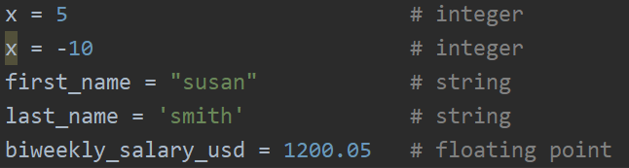
Variables - examples
The type of the variables is based on the value stored in the variable

Slide 8

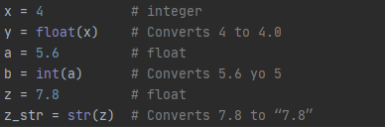
Variables - Types
The type of the variable will change if the type of the value changes
The type of a variable can be changed using built-in functions

Slide 9
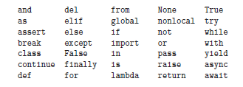
Naming Conventions
Choose meaningful names that document what the variable is used for
https://en.wikipedia.org/wiki/Mars_Climate_Orbiter
Can contain letters, numbers, and the underscore character but cannot start with a number
Cannot use reserved Python keywords:

Slide 10
Naming Conventions
lower_snake_case for variables, modules and function names
my_input, first_name, last_name, print_result
UPPER_CASE for constants (whose values will not change)
PI = 3.14, GRAVITY_M_SEC_SQ = 9.8
UpperCamelCase for classes (covered in lesson 11)
BankAccount, CoinFlip, Animal

Slide 11


Built-in Functions
Input from the Console (keyboard) using the built-in function input()
Prompts the user for some input from the console
Console would look like this

Slide 12


Built-in Functions
input() can also take a prompt to reduce code
Console

Slide 13
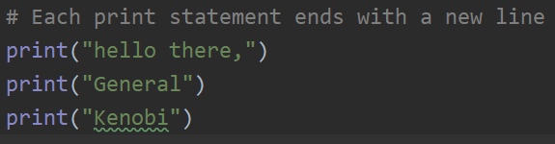



Built-in Functions
Output to the Console (Screen) using the built-in function print()

Slide 14


Built-in Functions
Everything in python is an object, including variables like integers and strings. More will be discussed later on objects.
The built-in function type() will return the data type of an object
The built-in function id() will return the id of an object, an integer that uniquely identifies the object in a program

Slide 15
Arithmetic Operators
An expression is a combination of items that evaluates to a new value
variable – stored value, can have different values at different points in time
literal – specific value such as 2
operator – symbol that performs a built in calculation
Arithmetic Operators in Python:
+ Addition (x + y)
- Subtraction (x – y)
* Multiplication (x * y)
/ Division (x / y)
// Integer Division (result will be a whole number; any decimal portion is thrown away, not rounded)
** Exponent (x to the power of y)
% Modulus (remainder after dividing)

Slide 16
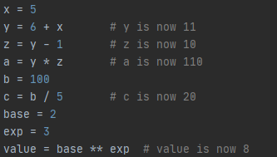
Arithmetic Operators
Some examples

Slide 17
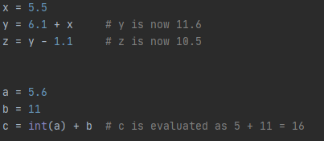
Arithmetic Operators
Some more examples

Slide 18
Categories of Errors
Syntax – The rules of the programming language
Syntax Error – A violation of the programming language rules. Usually caught by the interpreter before any lines of the program are run.
Run your program frequently to catch these errors, especially if you are new to programming
Very common error for new programmers is a typo. Make sure everything is spelled correctly and names match (case sensitive!)

Slide 19
Categories of Errors
Runtime Error – When the program is run by the interpreter and then crashes
Runtime Error – Correct syntax but the program attempts to do something that is impossible such as divide by zero or trying to multiply strings.
The program immediate stops and reports and error at the line of code being run so it is often called a crash. Common Runtime Error Types:
SyntaxError – Code that cannot be understood (but was not caught at startup)
IndentationError – Lines of the program are not indented correctly
ValueError – Invalid value is used (i.e., passing a string value to int())
NameError – Program tries to use a variable that does not exist
TypeError – An operation uses incorrect types (i.e., adding an integer to a string)

Slide 20
Categories of Errors
Semantic – The intended purpose of your program is not being met
Semantic Error – Your program runs but does not do what you intended it to do. Also known as a Logic Error.
Examples:
Your program is supposed to add x and y and print the result, but always prints the value of x
Your program is supposed to load in data from a file, but the variable holding that data is always empty

Slide 21
Programming Best Practices/Advice
Make your code readable to others:
Use comments to describe why you’ve done something
Use whitespace (e.g., blank lines) to separate groupings of code
Don’t be afraid to ask for clarification… but do try to understand yourself first
Don’t be afraid to experiment with your code
You can’t cause any serious harm (generally)
You can always recover
Worst case you start writing your program over again (for simple programs)

Slide 22
Homework
Review the material
Complete the lab
Pre-read chapter 4 on Functions
Quiz next lesson on today’s topics as well as a pre-reading question

